Slide 1

Computer Solution Technology
Rajesh Rajchal
MSSE 663 Web Frameworks
Course Prof. Jelena Vucetic
Regis University

Slide 2
Features
Users
View All products
View specific products
Purchase
Manager
All users can do CRUD features

Slide 3
Architecture
Initially planned: MVC
More like Client – Server Architecture
Client: Front End – All front pages or Views
Server: Back End – Model and Controllers

Slide 4
Web Contents
Product
User
(Admin and Non-Admin)
Payment

Slide 5
Problems and Prospects
Plan with Architecture Design
Plan the UX
Software Testing, also need to test from *.spec.ts

Slide 6
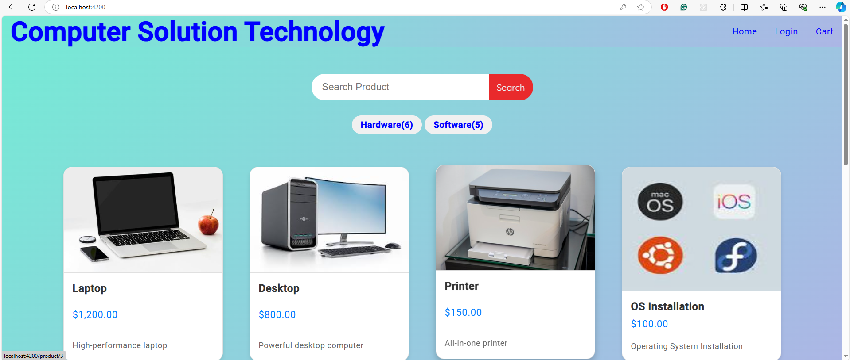

Slide 7
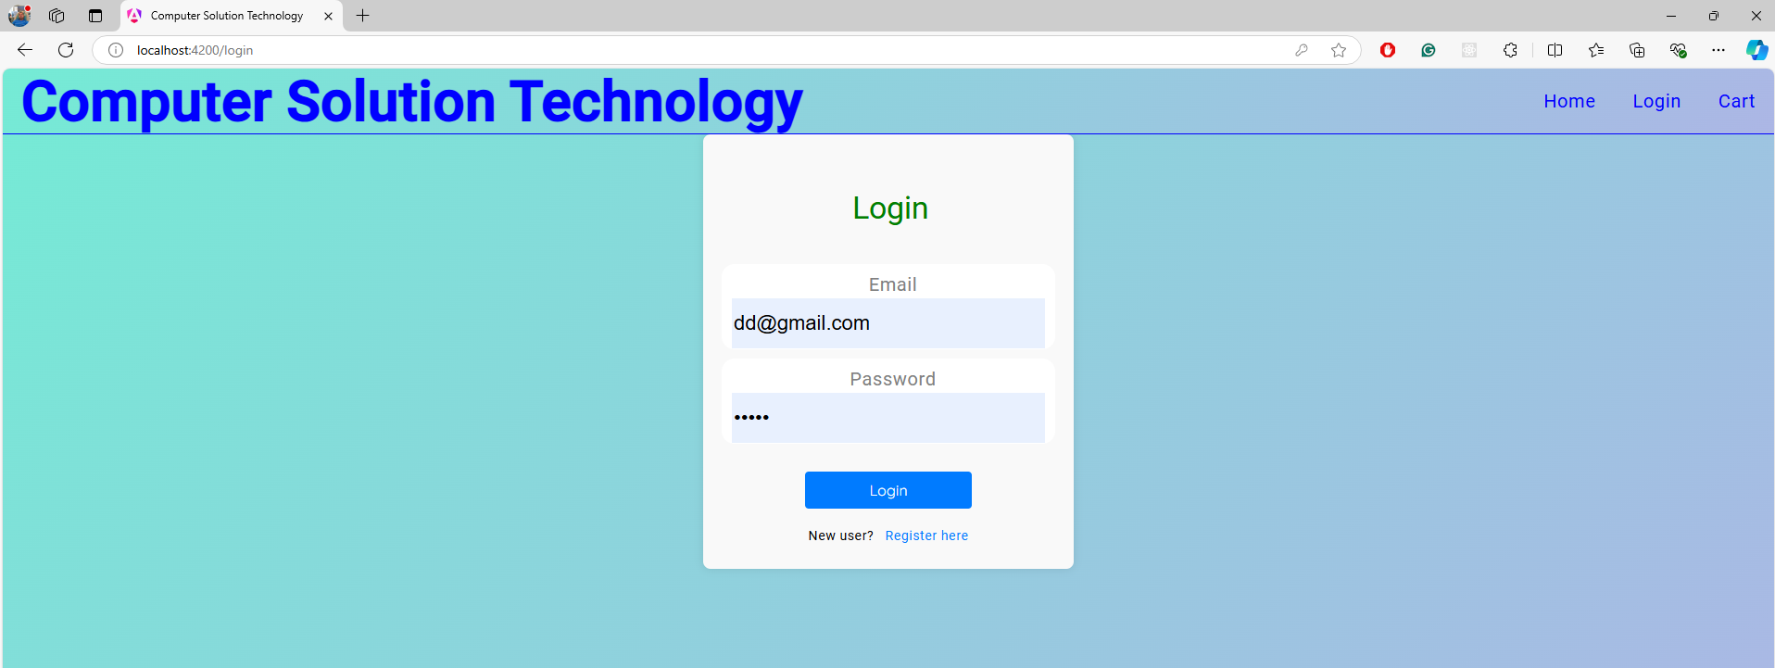
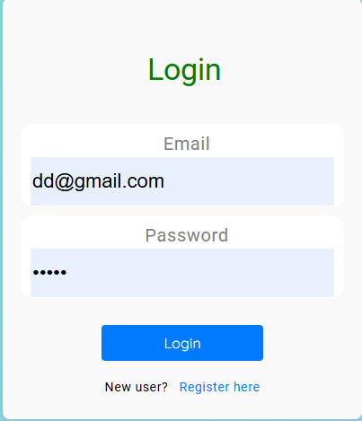

Slide 8
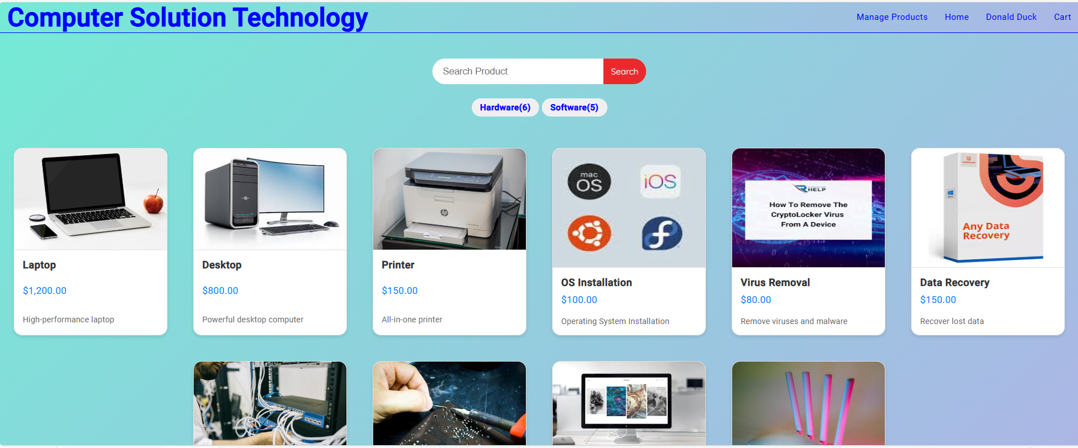

Slide 9
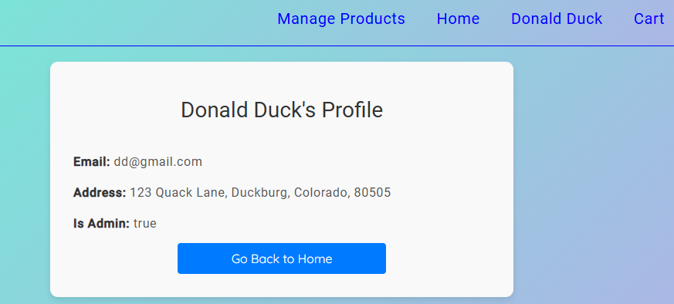
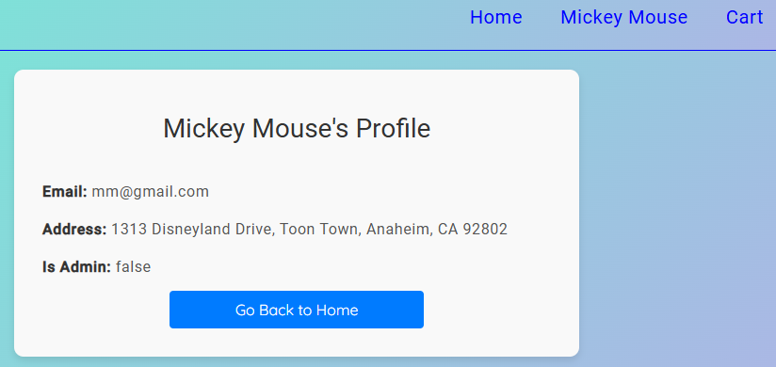
Admin Privileges: A Comparative View

Slide 10
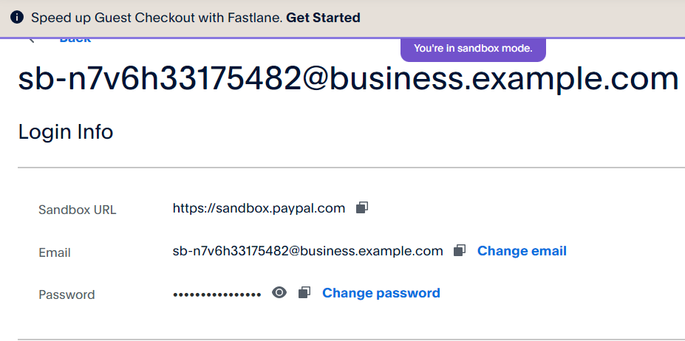
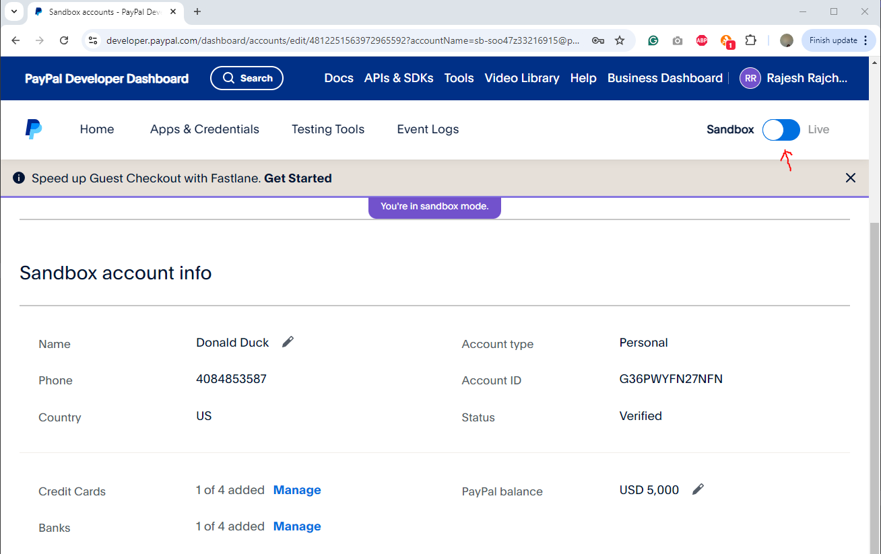
PayPal Sandbox Account

Slide 11
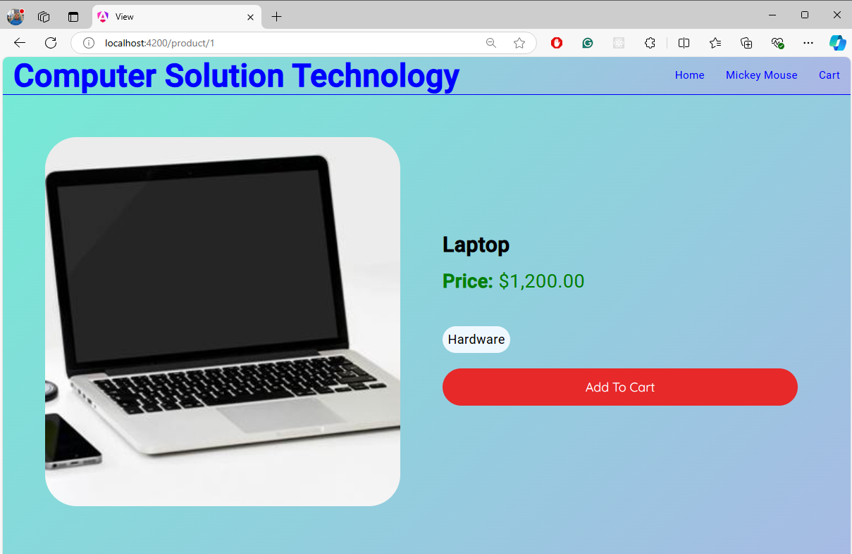
Add to Cart

Slide 12
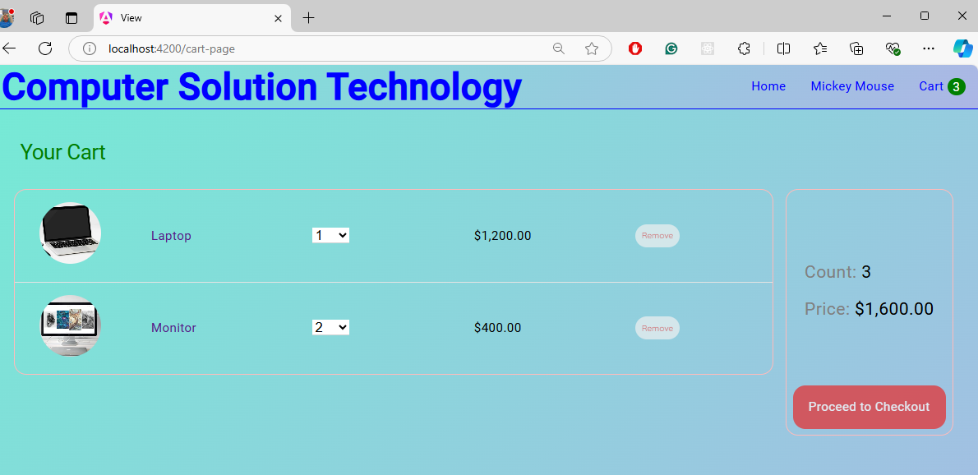
Add to Cart

Slide 13
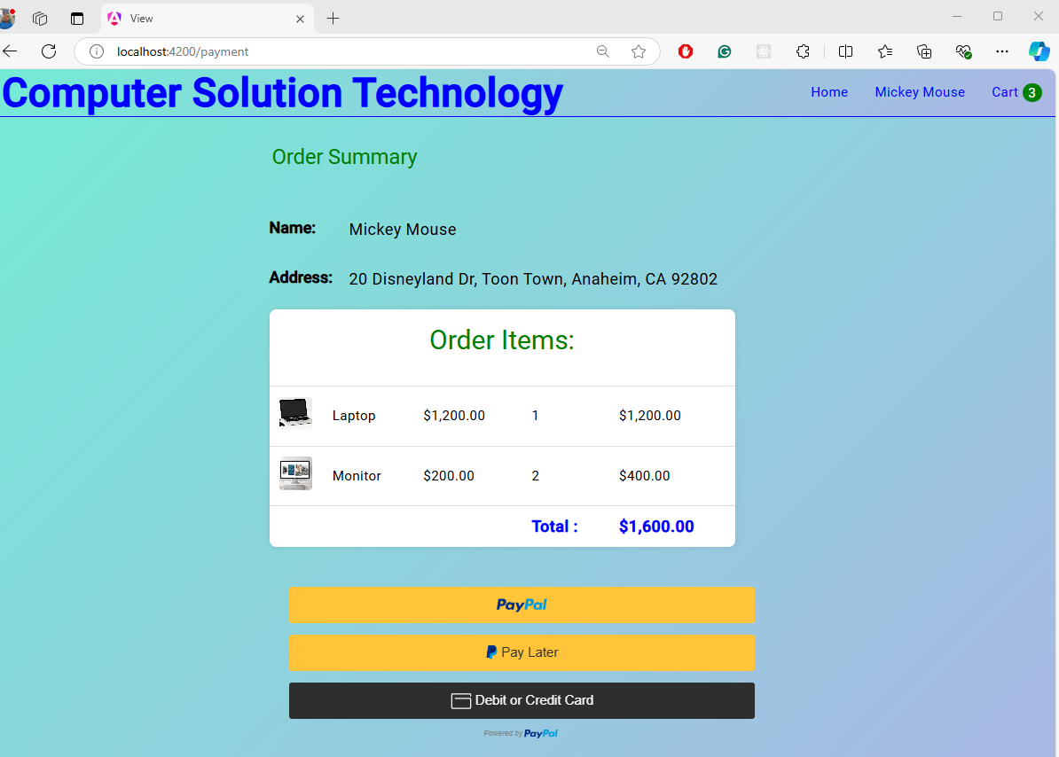
Payment

Slide 14
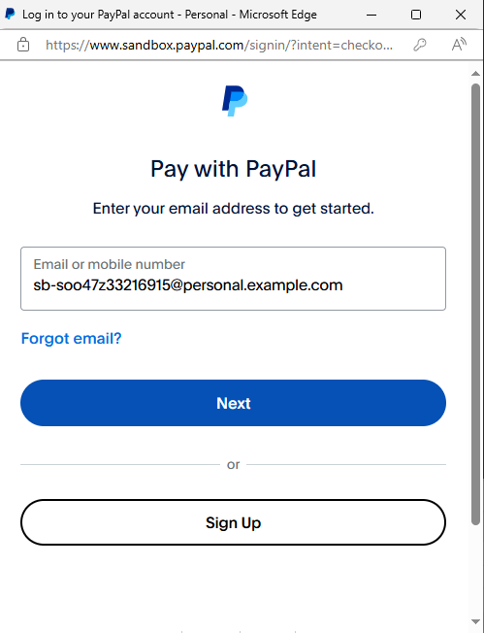
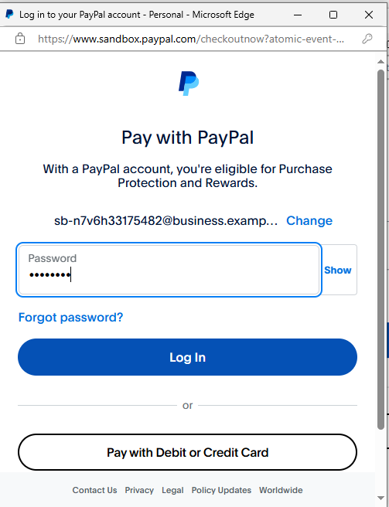

Slide 15
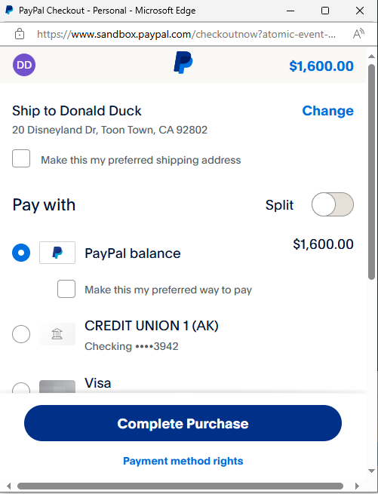
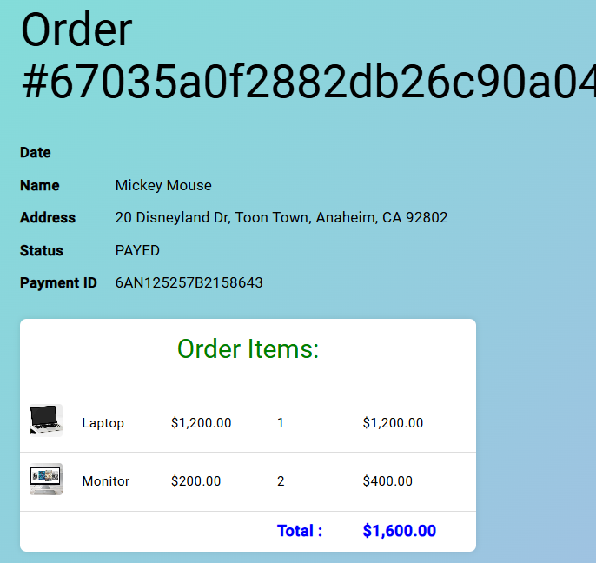

Slide 16
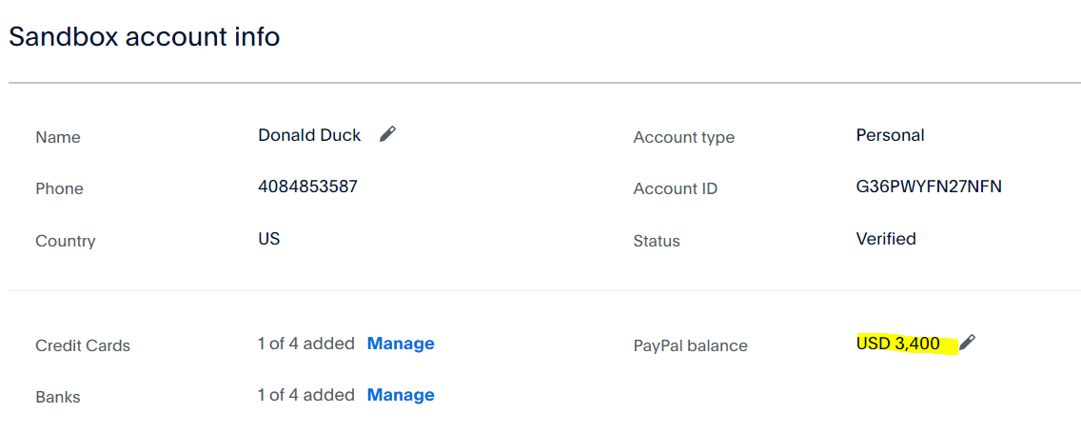
5000-1600=3400

Slide 17
Feature: Accessibility
High Contrast Mode: Provides a high contrast mode to assist users with visual impairments in distinguishing between different items.
Simplified Navigation: A clear and straightforward navigation system to help users with cognitive disabilities find the services they need.
Screen Reader Compactivity: Dynamically change the view for smaller or bigger screens.

Slide 18

API Testing
Extremely helpful in API testing, especially, Create, Read, Update, Delete
Orders
Also, helpful in checking Products, Debug

Slide 19
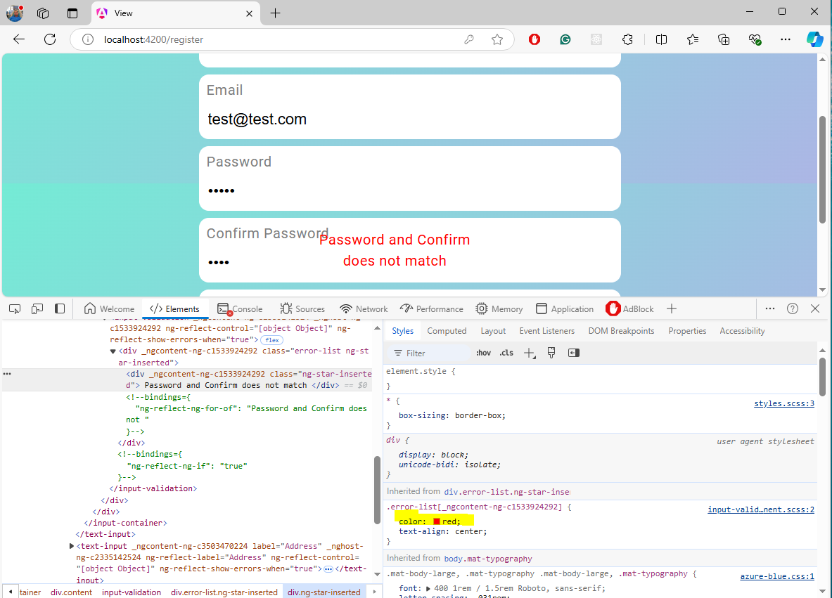
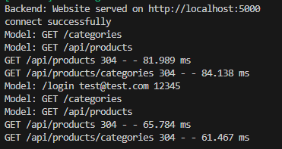
Debugging with Console and Elements

Slide 20

Security
Encrypting Password:
const encryptedPassword = await bcrypt.hash(password, 10);
Authenticating with Guard: Validates user’s access
ng g guard auth
Add authentication Token: Attach authentication tokens and credential
ng g interceptor auth
Authentication with Username and Password
12345

Slide 21
Lesson learned
Work on Software Design first

Slide 22
Resources
This class
https://foodmine-new.herokuapp.com
ChatGPT: SCSS, Compilation Errors, especially imports

Slide 24
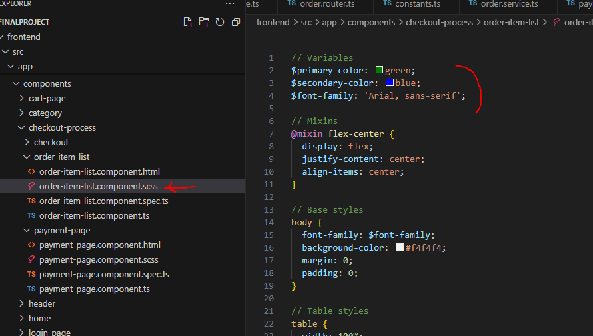
scss: Sassy Cascading Style Sheets

